Slide 1
How to debug a website using IE F12 tools
David Catuhe | Principal Program Manager
Etienne Margraff | Technical Evangelist

Slide 2
Course Topics
How to debug a website using IE F12 tools
01 | Working with web standards | 02 | Debugging with the console and the debugger windows
03 | Optimizing your page | 04 | Developing a mobile web site
05 | Testing on all browsers

Slide 3
04 | Developing a mobile web site
David Catuhe | Principal Program Manager
Etienne Margraff | Technical Evangelist

Slide 4
Module Overview
Using Visual Studio
Tools
Challenges with mobile websites

Slide 5
Developing a mobile web site Using Visual Studio

Slide 6
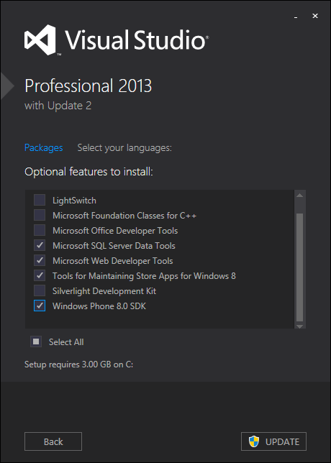
Debugging in Visual Studio
Download the Visual Studio installer
Be sure to check Windows Phone SDK

Slide 7
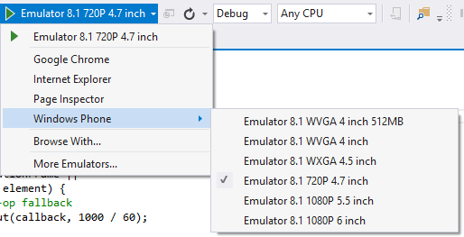
Debugging in Visual Studio
Turn on the Standard toolbar
The Debug menu will now have Windows Phone as an option

Slide 8
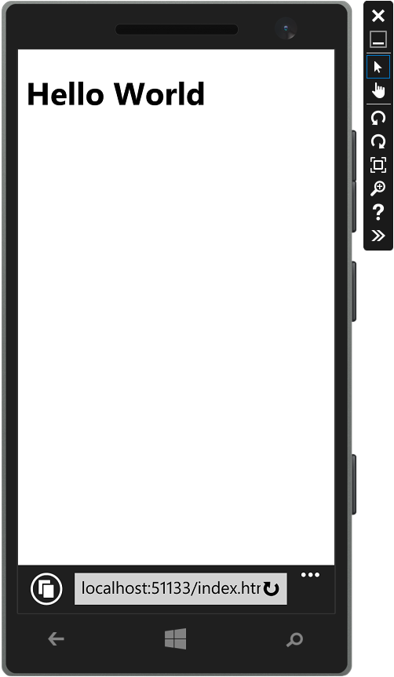
Debugging in Visual Studio
You can now debug your site in the emulator

Slide 9
Developing a mobile web site Demo

Slide 10
Developing a mobile web site Tools

Slide 11
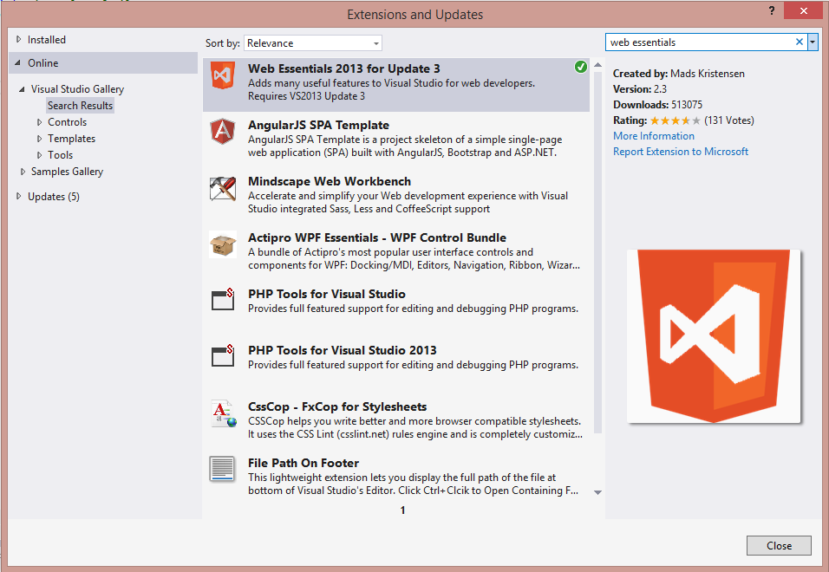
Install Web Essentials Plugin
Tools -> Extensions and Updates

Slide 12
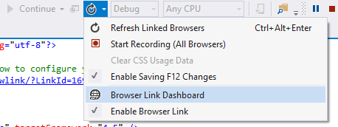
Enable BrowserLink Dashboard
Click the Enable option in the toolbar
Open the Dashboard

Slide 13
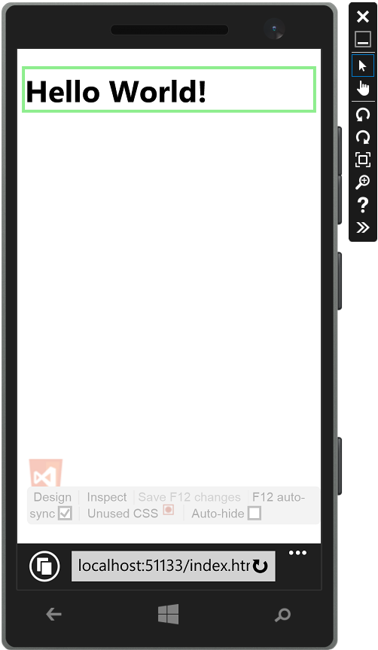
BrowserLink
Design, Inspect mode allows you to choose an element and pull it up in VS

Slide 14
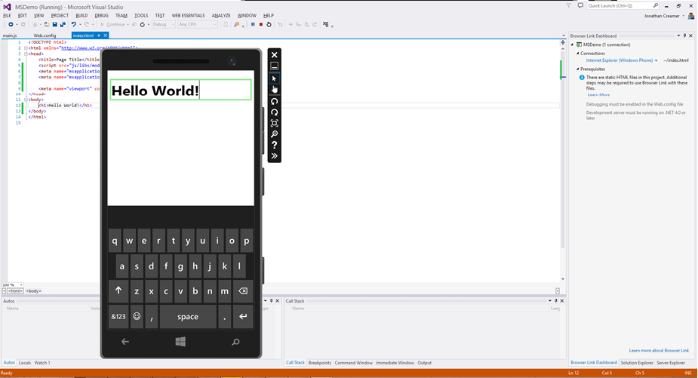
BrowserLink

Slide 15
BrowserLink
Might need this if working with a static HTML file
<system.webServer>
<handlers>
<add name="Browser Link for HTML" path="*.html" verb="*"
type="System.Web.StaticFileHandler, System.Web, Version=4.0.0.0, Culture=neutral, PublicKeyToken=b03f5f7f11d50a3a"
resourceType="File" preCondition="integratedMode" />
</handlers>
</system.webServer>

Slide 16
Developing a mobile web site Demo

Slide 17
Developing a mobile web site Challenges with mobile websites

Slide 18
Mobile Should Just Work
A priority for the web to just work anywhere
DO NOT USE browser detection
Stop targeting webkit prefixes and focus on standards
Mobile IE automatically maps webkit prefixes to the appropriate standard
Support both mouse AND touch
Notes:
In general like with IE desktop, if you code against modern standards, websites should work well with IE mobile
IE mobile is designed to work and be compatible with other standards based websites

Slide 19
Multi-input Devices
We use to be able to rely on a single pointing device: the mouse
But now users have multiple input devices!
Surface Pro: touch screen, but also possibly a mouse and stylus!
This is the impetus for "pointer" events
allows handling of any input type with proper data using a single API

Slide 20
Mouse vs Touch vs Pointer
In the past, we attached to mouse events like "click" and mouseover
Then browsers added touch events for capacitive screens
These included things like touchstart and touchmove
Comabinable to simulate things as tap and swipe events
Now we have pointer events to unify both concepts
Uses abstract terms to cover mouse, finger, stylus, etc.
Notes:
May want to talk about how "clicks" and "taps" are very similar, but not exactly the same. Also note that "touch" events were introduced by Apple with Safari on iOS.

Slide 21
Pointer Events
Intended to abstract any input to a single set of events
Default browser action and data can vary depending on input type
Currently only fully supported in IE 10+
IE 10 requires the ms vendor prefix to use
W3C candidate recommendation
Notes:
Note that there is some initial support in Firefox that can be enabled by a user config setting, however, the implementation is a bit different (especially for multi-touch).

Slide 22
Pointer Events
Pointer events
generally mimic existing mouse events
are fired from any pointing input device (stylus or finger):
We also get the pointercancel event (same as touchcancel)
mousedown
mouseenter
mousemove
mouseup
=> pointerdown
=> pointerenter
=> pointermove
=> pointerup

Slide 23
Handling Pointer Events
Pointer events are handled just like any other:
someElement.addEventListener("pointerdown", function (evt) {
// handle just like you might a "mousedown" event,
// but you can inspect evt.pointerType to tailor actions to input type
});

Slide 24
Using Hand.js
This is a polyfill for the pointer events specification
It allows a developer to handle pointer events across most browsers
No need to handle
mousexxx and touchxxx events for other browsers
pointerxxx for IE

Slide 25
Using Hand.js
Using the library is simple, include the library JS file and use pointer events:
<script src="hand.minified-1.2.1.js"></script>
...
<script>
someElement.addEventListener("pointerdown", function (evt) {
//works in all major browsers!
});
</script>

Slide 26
Using Hand.js
Note that various event object properties will be filled in with defaults
If the browser does not provide information on tilt, for example, it will be zero (0)
Additionally, the pointerType will simply be set to mouse for non-supported browsers
Lastly, setting the pointer capture element is not supported (polyfilled)

Slide 27
Developing a mobile web site Demo

